Slide 1

MALLA REDDY COLLEGE OF ENGINEERING FOR WOMEN
(Approved by AICTE New Delhi and Affiliated to JNTUH)
(B.Tech Programs-CSE & ECE Accredited by NBA)
(An ISO 9001 : 2015 Certified Institution)
Maisammguda, Medchal (M), Hyderabad-500100,Telangana
“5G SMART DIABETES DIAGNOSIS TOWARDS PERSONALIZED DIABETES WITH HEALTH CARE BIG DATA CLOUDS”
Submitted by
P.POOJA 21RG1A0540
S.ARCHANA 21RG1A0550
S.KAVYACHANDRIKA 21RG1A0552
T.AKHILA 22RG5A0506
Under the Guidance of
AVYAKTHA.E
M.TECH, ASSISTANT PROFESSOR

Slide 2
ABSTRACT
Recent advances in wireless networking and big data technologies, such as 5G networks, medical big data analytics, and the Internet of Things, along with recent developments in wearable computing and artificial intelligence, are enabling
the development and implementation of innovative diabetes monitoring systems and applications.
Due to the life-long and systematic harm suffered by diabetes patients, it is critical to design effective methods for the diagnosis and treatment of diabetes.
Based on our comprehensive investigation, this article classifies those methods into Diabetes 1.0 and Diabetes 2.0
which exhibit deficiencies in terms of networking and intelligence. Thus, our goal is to design a sustainable
cost-effective, and intelligent diabetes diagnosis solution with personalized treatment.
Notes:
5233074260

Slide 3
INTRODUCTION
CONCEPT
Diabetes is an extremely common chronic disease from which nearly 8.5 percent of the world population suffer; 422 million people worldwide have to struggle with diabetes.
More critically, the situation will be worse, as reported in with more teenagers and youth becoming susceptible to diabetes as well.
Due to the fact that diabetes has a huge impact on global well being and economy, it is urgent to improve methods for the prevention and treatment of diabetes.
PROBLEM SOLUTION
To solve the above problems, in this article, we first propose a next generation diabetes solution called the 5G-Smart Diabetes system
which integrates novel technologies including fifth generation (5G) mobile networks, machine learning, medical big data, social networking, smart clothing , and so on.

Slide 4
SYSTEM ANALYSIS
EXISTING SYSTEM:
As there is no staff available in unmanned restaurants, it is difficult for the restaurant management to estimate how the concept and the food is experienced by the customers. Existing
The rating systems, such as Google and Trip Advisor, only partially solve this problem, as they only cover a part of the customer’s opinions.
These rating systems are only used by a subset of the customers who rate the restaurant on independent rating platforms on their own initiative.
This applies mainly to customers who experience their visit as very positive or negative.
Notes:
The

Slide 5
ADVANTAGES OF PROPOSED SYSTEM
Smartness
With cognitive intelligence toward patients' status
network resources
5G-Smart Diabetes achieves early detection and prevention of diabetes and provides personalized treatment to patients.

Slide 6
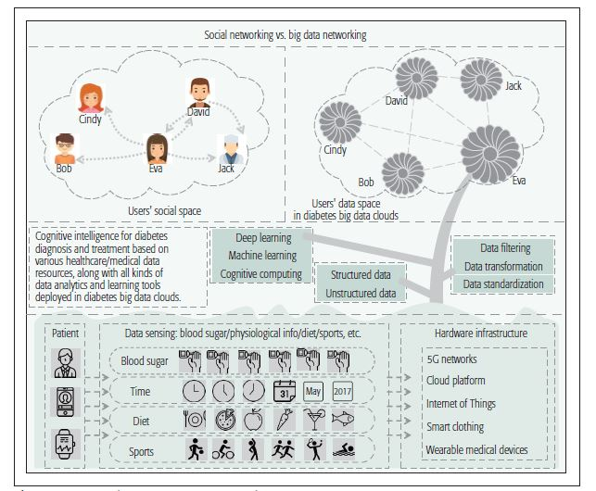
SYSTEM ARCHITECTURE

Slide 7
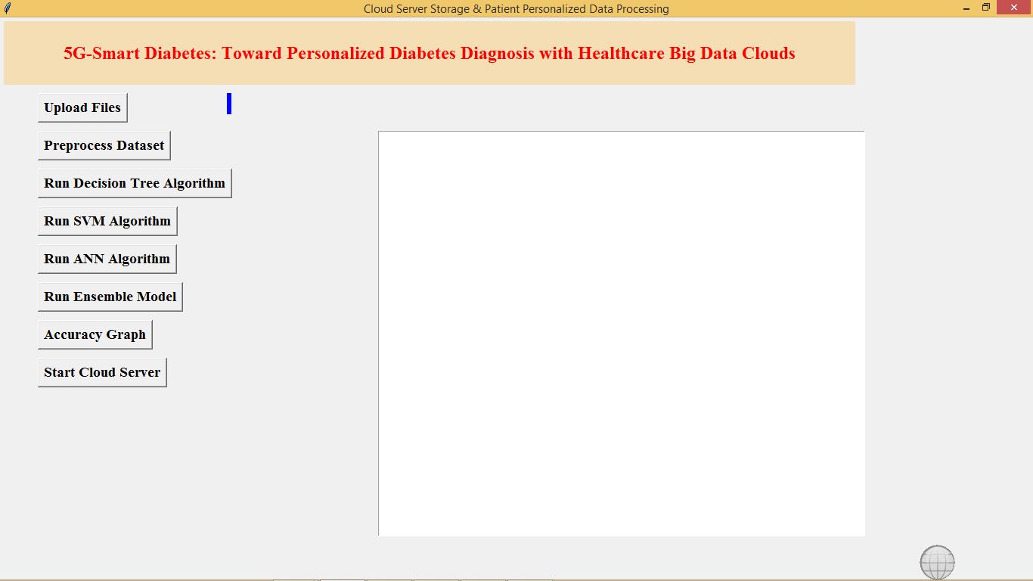
RESULT
Fig-1: Upload Files

Slide 8
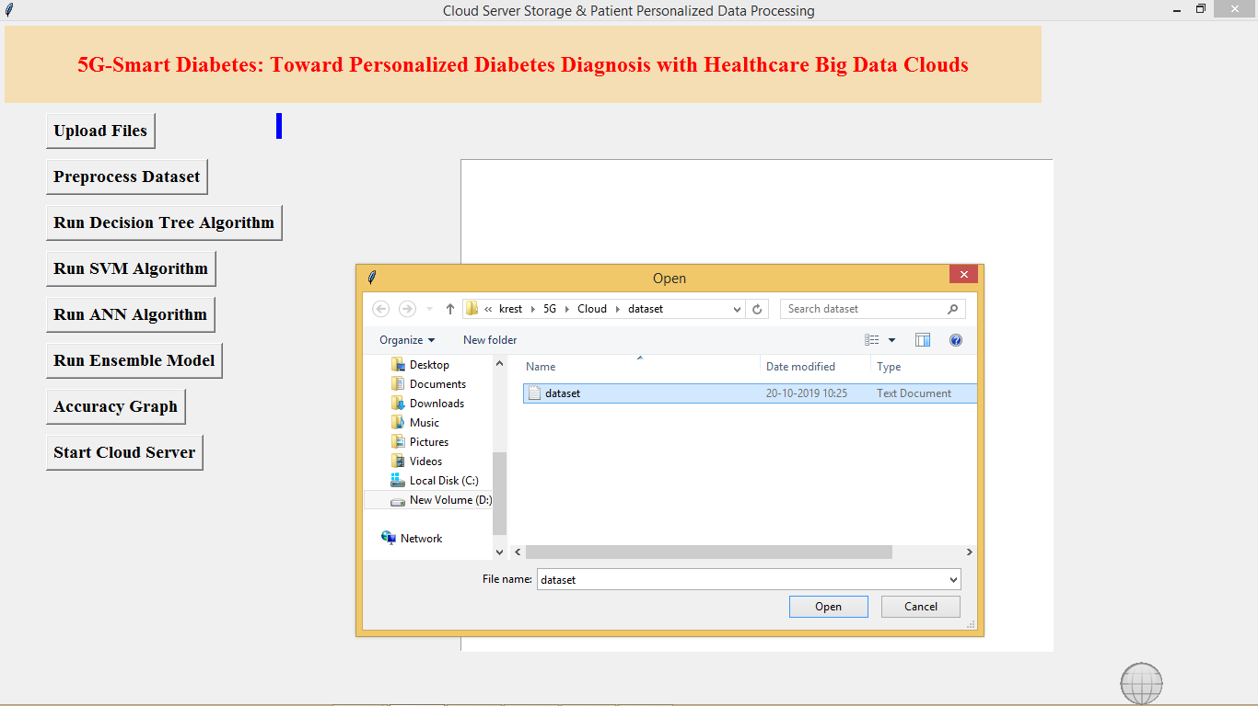
Fig-2:Pre-process Dataset

Slide 9
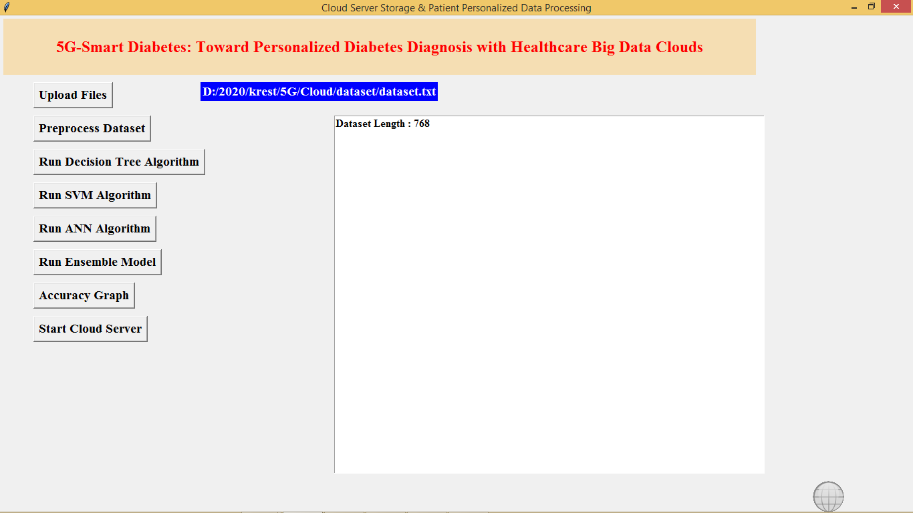
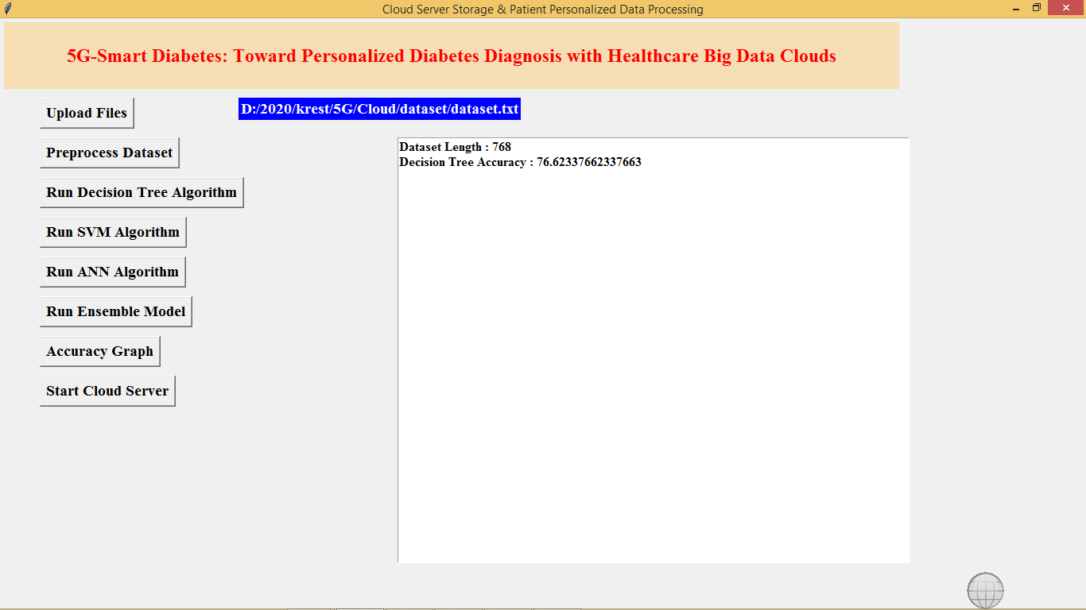
Fig-3: Run Decision Tree Algorithm
Fig-4:Run SVM Algorithm

Slide 10
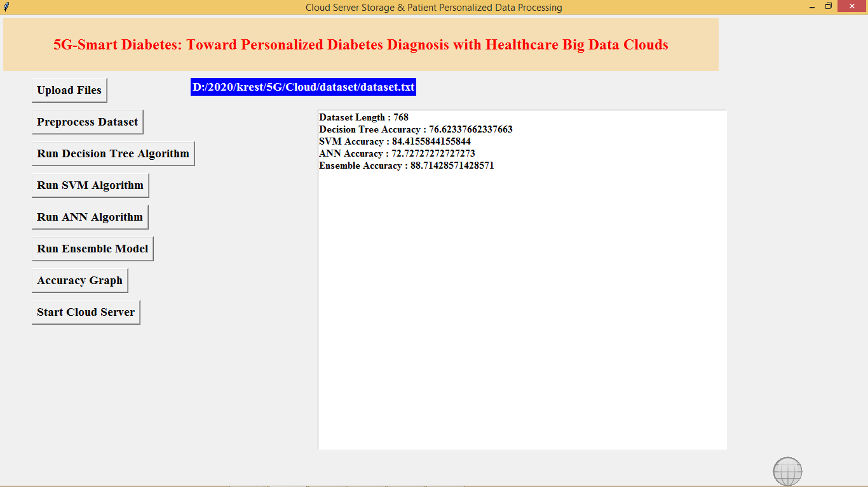
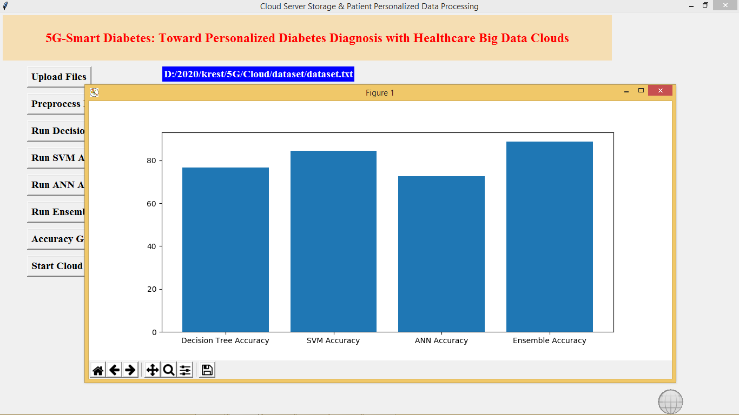
Fig-5:Run ANN Algorithm
Fig-6:Accuracy Graph

Slide 11
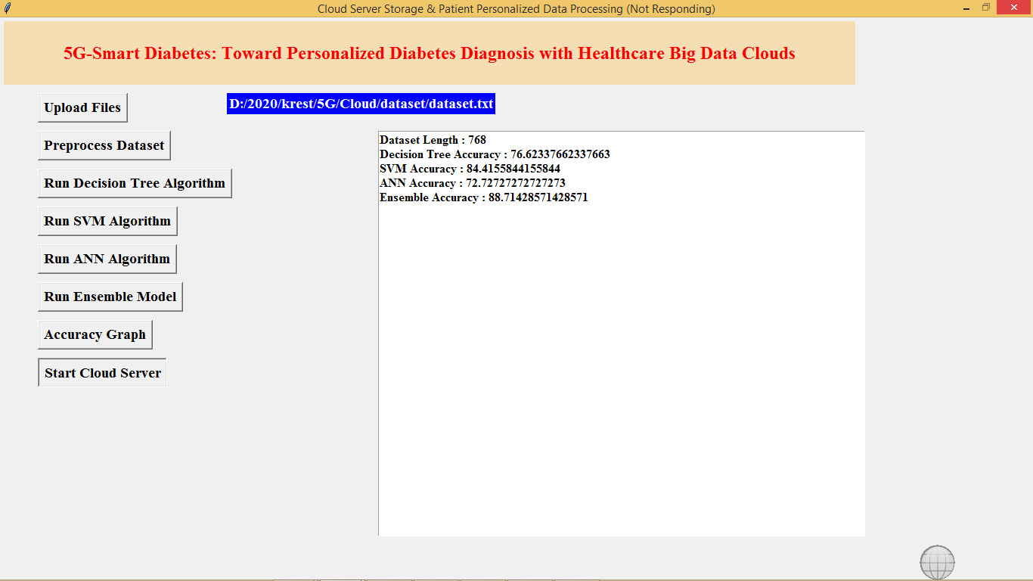
Fig-7 :Start Cloud Server

Slide 12
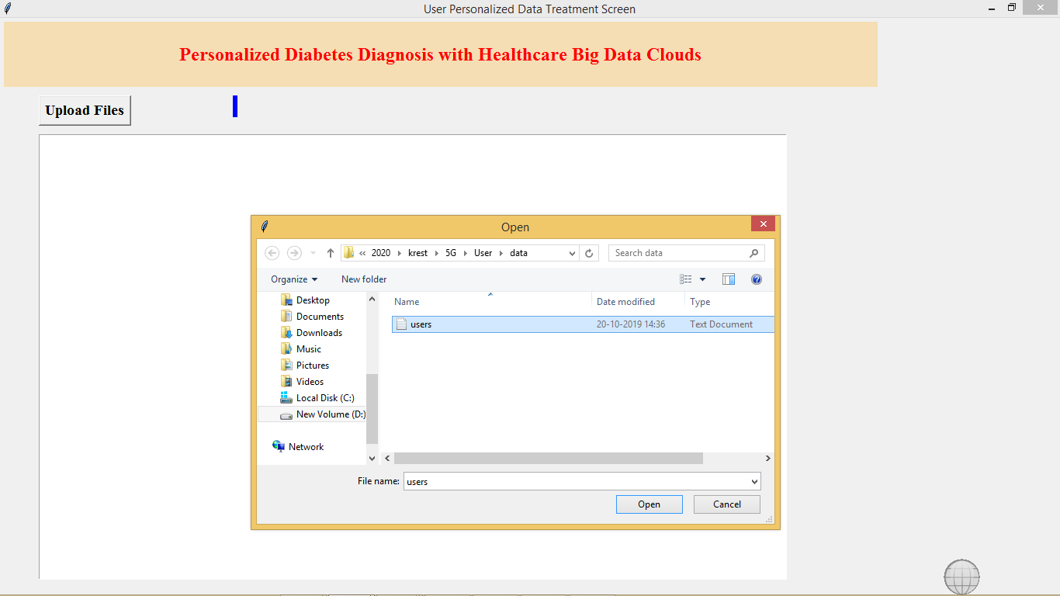
Fig-8:Upload User Details

Slide 13
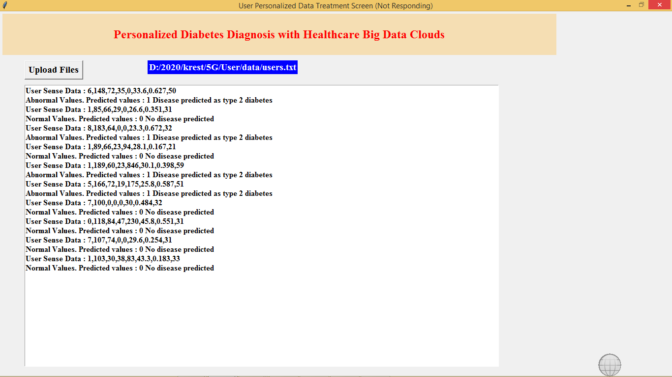
Fig 9:Details of patient

Slide 14
CONCLUSION
In this article, we first propose a 5G-Smart Diabetes system that includes a sensing layer, a personalized diagnosis layer, and a data sharing layer.
Compared to Diabetes 1.0 and Diabetes 2.0, this system can achieve sustainable, cost-effective, and intelligence diabetes diagnosis.
Then we propose a highly cost-efficient data sharing mechanism in social space and data space.
In addition, using machine learning methods, we present a personalized data analysis model for 5G-Smart Diabetes. Finally, based on the smart clothing, smartphone and data center, we build a 5G-Smart Diabetes test.

Slide 15


